Slide 1
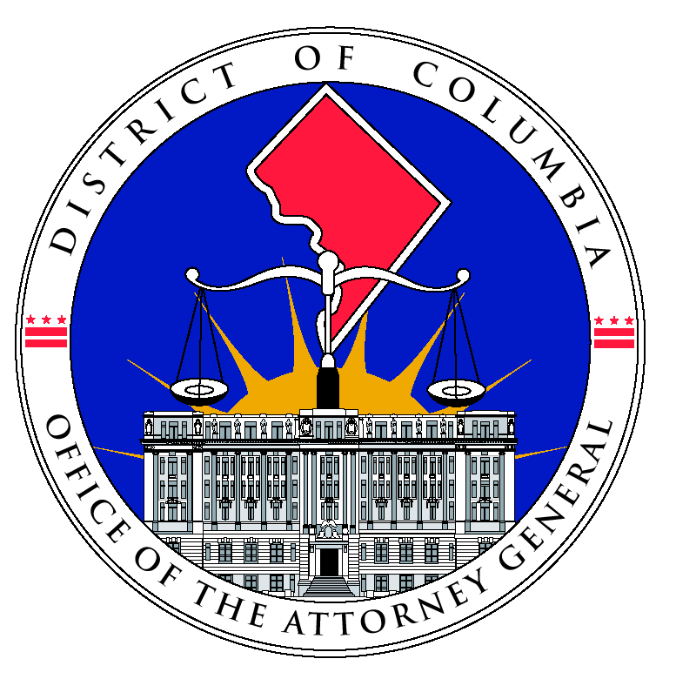
Victims’ Rights in the Family Court and Overlap with the Adult System

Slide 2
Introduction
Goals of the Presentation
Basic Rights – Juvenile and Adult Cases
Video Presentation
Victim’s Bill of Rights in the Juvenile System
D.C. Crime Victims’ Bill of Rights
Crime Victims’ Rights Act
USDOJ Attorney General Guidelines for Victim and Witness Assistance
D.C. Crime Victims’ Compensation Program

Slide 3
DVD and Alternate Sexual Assault Scenarios
Which Systems Are Involved
Neglect – Parent Assault and Failure to Protect
Types of Crimes
Juvenile Offenses and Adult Offenses
Domestic Violence
Sexual Assault
ADW
Assault
Gun offenses
Child Abuse (criminal)
Child Neglect

Slide 4
Outline for Today’s Presentation
Juvenile and Adult Systems
Definition of Victim
Victims’ Rights Statutes and Guidelines
Victims’ Rights at each Stage of the Criminal Justice Process:
Pre-Arraignment/Pre Initial Hearing
Arraignment /Initial Hearing
Hearings
Trial
Plea Hearing
Sentencing (Dispositions)
Restitution
Post-Conviction (Post-Disposition)

Slide 5
Definition of Victim – Juvenile System – §16-2301 41(A)
A person, organization, partnership, business, corporation, agency or governmental entity.....
Any of the above against whom a crime, delinquent act, (or attempt) has been committed:
Who suffers physical or mental injury;
Who may have been exposed to the HIV/AIDS virus;
Who suffers any loss of property, including pecuniary loss.
Victims’ Bill of Rights in the Juvenile System

Slide 6
Definition of Victim: D.C. Crime Victims’ Bill of Rights
Victim
§ 23-1905 (2)(A)
The term “victim” or “crime victim” means a person who or entity which has suffered direct physical, emotional, or pecuniary harm:
(i) As a result of the commission of any felony or violent misdemeanor in violation of any criminal statute in the District of Columbia;
(ii) While assisting lawfully to apprehend a person reasonably suspected of having committed or attempted a crime;
(iii) While assisting a person against whom a crime has been committed or attempted if the assistance was rendered in a reasonable manner; or
(iv) While attempting to prevent the commission of a crime.
Notes:
General Bill of Rights
Unreasonable Delay
Fairness, Dignity and Respect
Right to Confer

Slide 7
Federal Victims’ Rights Laws
Victim Rights and Restitution Act
42 U.S.C. § 10607
Investigators, prosecutors, and others must ensure that victims receive certain rights and services
Crime Victims’ Rights Act –
18 U.S.C. § 3771
Court-related protections for child victims and witnesses (18 U.S.C. § 3509)
Alternatives to live, in-court testimony
Privacy protections

Slide 8
Definition of Victim under the CVRA 18 USC 3771(e)
If victim is a minor, incompetent, incapacitated, or deceased → legal guardians, estate representatives, family members, or others designated by court (but not the defendant).
“A person directly and proximately harmed as a result of the commission of a Federal offense or an offense in the District of Columbia.”
Notes:
List of Rights Pursuant to the CVRA

Slide 9
USDOJ Attorney General Guidelines for Victim and Witness Assistance
First edition published in 1985 and revised approximately every five years.
Employees in federal agencies "engaged in the detection, investigation, or prosecution of crime shall make their best efforts to see that crime victims are notified and accorded” their rights under the CVRA.
Federal cases involving Juvenile Offenders
Federal Juvenile Delinquency Act
Presumption of providing services rather than withholding them.
Overarching Principle: Treating victims with fairness, dignity and respect.

Slide 10
Remedies and Enforcement Provisions
Adult System
D.C. Crime Victims’ Bill of Rights
Crime Victims’ Rights Act
Motions
Writs of Mandamus
Administrative Complaint Process – Victim Rights’ Ombudsman
Sanctions for willful violations
Juvenile System

Slide 11
Contrast with Neglect Proceedings
Best Interests of the Child
Child as Party to Proceeding – can sit-in
Timing of Hearing is Child-centric
No corresponding “Bill of Rights”
Child’s Testimony
In re JAM.J, 825 A.2d 902 (D.C. 2003)
Three-part balancing test
Medical records in a neglect proceeding

Slide 12
Victims’ Rights During the Court Process

Slide 13
Juvenile Proceedings
Purpose Clause – §16-2301.02
Protecting the needs of the community
All other interested parties
Public Safety considerations

Slide 14
Pre-Arraignment/Pre-Initial Hearing Rights in Juvenile and Adult Criminal Proceedings

Slide 15
Juvenile Proceedings and Confidentiality
General premise: Juvenile, social file, and law enforcement case records shall be kept confidential and not open to inspection.
Law Enforcement Records: D.C. Code §16-2333(b)(12)
Records may be viewed by each eyewitness, victim or immediate family members or caretakers of the eyewitness or victim, when the records relate to the incident in which they were an eyewitness or victim.

Slide 16
Juvenile Proceedings and Confidentiality
At the discretion of the AG’s office, each eyewitness, victim, or immediate family member of the above, may be provided information on the following:
Release status
Level of respondent’s placement
Stay-away orders imposed
Respondent’s participation in diversion or consent decree
Offenses charged in petition
Terms of plea agreements, findings or verdicts
Commitment or probation status
May not release mental health information or social file records.

Slide 17
HIV Testing
Juvenile Court – Right to HIV/AIDS Testing
D.C. Code § 16-2315
Attorney General or designee may request testing
Must have hearing to determine whether there is probable cause to believe that a victim or eyewitness may have been put at risk
If probable cause is found, Division shall order that responded be tested
Results shall be presented by OAG to respondent and victim or eyewitness
Victim or eyewitness may only disclose the respondent’s identity to doctor or counselor

Slide 18
HIV/AIDS Testing
Adult cases
D.C. Code § 22-3902
Upon the request of a victim, the court may order a defendant convicted of first degree sexual abuse and certain other crimes to produce a blood sample to be tested for HIV.
D.C. authorities must conduct the test, notify the victim and defendant of results and offer appropriate counseling and support services.

Slide 19
Summary of Rights
Reasonable Right to Protection
Right to Reasonable, Accurate and Timely Notice
Right to Attend (or not be excluded)
Right to be Reasonably Heard
Reasonable Right to Confer
Right to Full and Timely Restitution as Provided in Law
Right to Proceedings Free from Unreasonable Delay
Right to be Treated with Fairness and with Respect for Victim’s Dignity and Privacy

Slide 20
Pre-Arraignment: Adult Cases
Reasonable Right to Protection
Emergency Witness Assistance Program (EWAP)
Witness Security Program
Crime Victims’ Compensation Program
VINE program
Victim Specialists
Crisis intervention
Safety planning
Referral to Crime Victims’ Compensation Program
Referral to counseling and other services
Explaining victims’ rights
Court accompaniment
Domestic Violence Intake Center

Slide 21
Crime Victims’ Privacy and Security - Adult Cases
Medical Records
Safety and Security
D.C. Code § 23-1903
Appropriate safeguards to minimize the contact that may occur between the victim and the victim’s family with the accused or the accused’s family and defense witnesses.
The accused or defendant, or his/her attorney or another person acting on behalf of the accused or defendant shall clearly identify himself or herself as being a representative of the accused or defendant.
A victim’s property held for evidence should be maintained in good condition and returned when it is no longer needed.

Slide 22
Arraignment and New Referrals
Juvenile Cases:
Notice to victims
Right to speak
Right to attend hearings and receive information
Exceptions to juvenile confidentiality statutes
Adult Cases:
Notice to Crime Victims
Right to be present (D.C. Code)
Right not to be excluded (CVRA)
Right to be heard (CVRA)
Right to submit written statement (D.C. Code)

Slide 23
Juvenile vs. Adult Hearings
Types of hearings:
Preliminary/Detention/Probable Cause
Status
Plea
Sentencing/Disposition
Record Sealing
Right to Support
Right to Attend
Rule on Witnesses
Right to be Heard

Slide 24
Trial and Other Court Proceedings
Juvenile:
Right to attend
Right to presence of a support person for victim or eyewitness
Adult :
Right to be present at all proceedings related to the offense (D.C. Crime Victims’ Bill of Rights)
If objection, court must make findings
Rule on Witnesses
Right not to be excluded (CVRA)
Court must make findings
Right to separate waiting areas

Slide 25
Disposition/Plea Hearings
Juvenile Matters
Right to Attend
Right to Obtain Information
Adult Criminal Cases
Right to Confer
Right to Attend
Right to be Heard (CVRA)
Presentence Report
Contact by PSR Writer
Contact by CSS Worker

Slide 26
Disposition and Sentencing
Disposition Hearings:
Pre-Disposition Report
Right to support during proceedings
Right to submit Victim Impact Statement
Inclusion of Victim Impact Statement
Judge’s consideration of Victim Impact Statement
Sentencing Hearings:
Pre-Sentencing Report
Right to submit a Victim Impact Statement
Inclusion of Victim Impact Statement in PSR
Community Impact Statements
Right to be heard at the Sentencing Hearing

Slide 27
Restitution – Juvenile Cases § 16-2320.01
Division may order a parent or guardian of a child, a child, or both to make restitution to:
(A) The victim;
(B) Any governmental entity;
( C) A third-party payor, including an insurer, that has compensated the victim for a property loss as a result of the crime.
Restitution may be ordered for property that has been stolen or destroyed and for medical, dental, funeral and mental health counseling expenses
A restitution hearing to determine liability of a parent, guardian, child or both shall be held within 30 days of the disposition hearing.
Director of Social Services is responsible for monitoring the collection and disbursement of periodic or installment restitution.

Slide 28
Restitution – Adult Cases
D.C. Code § 16-711
Court “may, in addition to any other sentence imposed as a condition of probation or as a sentence itself, require a person convicted of any offense to make reasonable restitution or reparation.”
Court shall consider: number of victims, actual damage of each victim, resources of the defendant, his/her ability to earn money; and his/her number of dependents.
Graffiti: § 22-3312
Identity Theft: § 22-3227.04
Insurance Fraud: § 22-3225.05

Slide 29
Post-Disposition – Juvenile
Right to Attend Post-Disposition Hearings
Right to Information
Limitations on the Ability of CSS and DYRS to Informally Close Cases

Slide 30
Post-Disposition – Adult
Written statement at release or parole hearing of the victim’s opinion whether the defendant should be granted release or parole.
Crime victims have the right to make a statement at defendant’s record sealing hearings.

Slide 31
Corrections Stage
USOJ Attorney General Guidelines for Victim and Witness Assistance
BOP Responsibilities
USPC Responsibilities
Notification of Release, Furlough, and Escape
Notice Relating to Revocation of Parole
Right to be heard at Parole Hearings
Notice regarding release of offender (no later than 30 days prior to release)
Notice regarding death of inmate while in custody
Transfer of Victim Impact Statement to supervising U.S. Probation Officer

Slide 32
Legal Clinics and Resources for Victims
DC OAG Victim Specialists
USAO-DC Victim Witness Assistance Unit
National Crime Victim Law Institute (NCVLI)
ABA
Pro bono legal clinics were funded by National Crime Victim Law Institute, under grant from the Office for Victims of Crime
Locations include: Maryland and the District of Columbia
Mission: representation, education, technical assistance, amicus curiae participation
D.C. Crime Victims’ Resource Center
Identity Theft Resource Centers
Maryland, Texas, California, ITRC

